Slide 1

Web security
Tarun Tanmay – N049
Jai Verma – N060

Slide 2

Managing Access Control

Slide 3
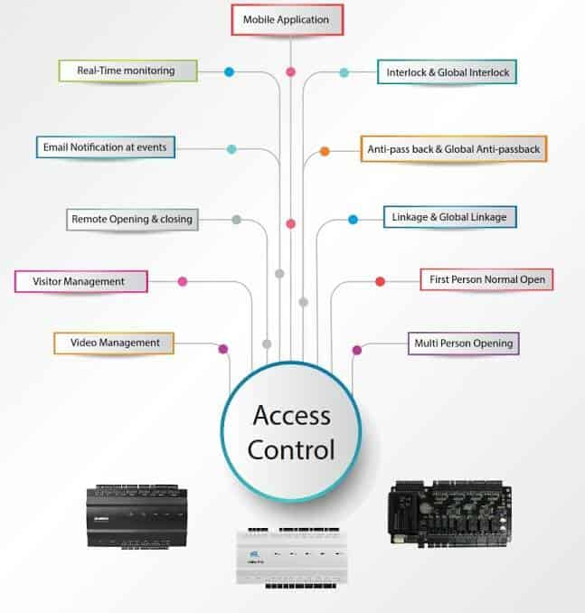
Access Control Management
Contents:
What is Access Control Management?
Physical Vs. Logical
How It Works?
Types of Access Control
Implementation

Slide 4

What is Access Control Management?
Access control is a security technique that regulates who or what can view or use resources in a computing environment. It is a fundamental concept in security that minimizes risk to the business or organization.
It is an important component of effectively managing the flow of people and restricting access where there is a need. Gone are the days when locking a door or putting up a temporary barrier are sufficient forms of access control. Now, businesses require better crowd control options to deliver an improved customer service relationship and keep people safe at all times.

Slide 5
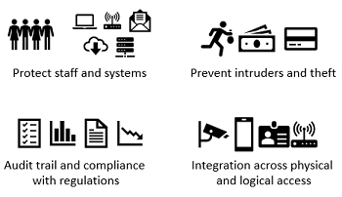
Physical Vs. Logical
There are two types of access control - physical and logical.
Physical access control limits access to campuses, buildings, rooms and physical IT assets.
Logical access control limits connections to computer networks, system files and data.

Slide 6
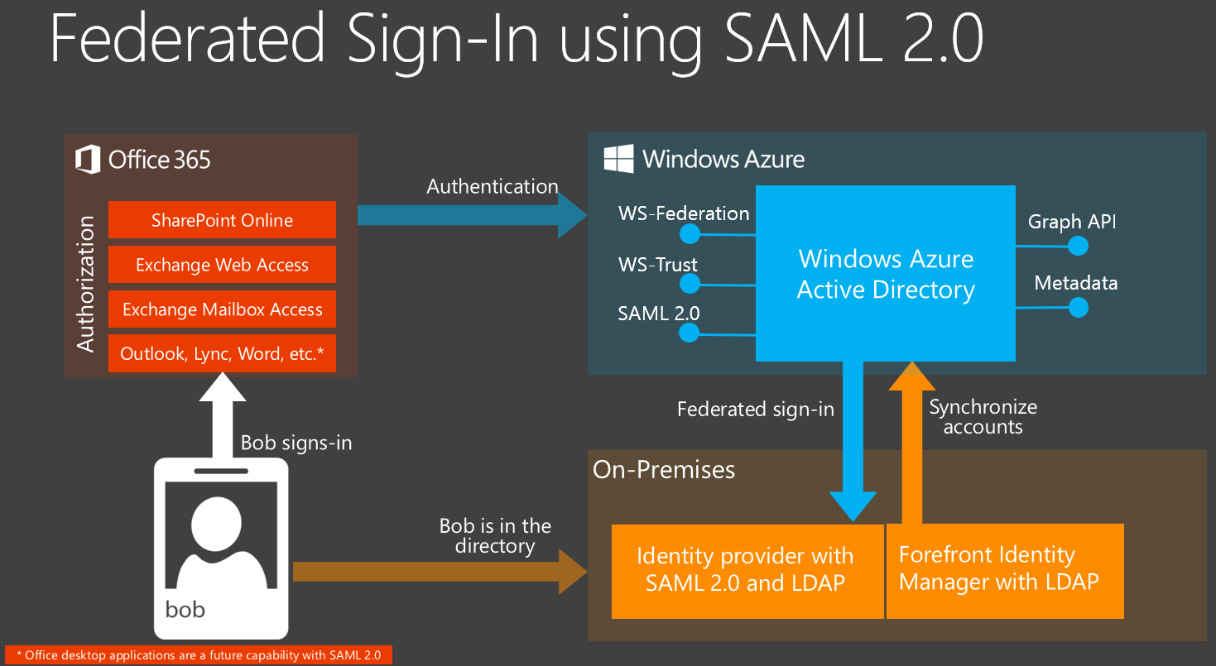
How It Works
These security controls work by identifying an individual or entity, verifying that the person or application is who or what it claims to be, and authorizing the access level and set of actions associated with the username or Internet Protocol (IP) address.
Directory services and protocols, including Lightweight Directory Access Protocol (LDAP) and Security Assertion Markup Language (SAML), provide access controls for authenticating and authorizing users and entities and enabling them to connect to computer resources, such as distributed applications and web servers.

Slide 7
Types of Access Control
Following are the main models of access control:
Mandatory Access Control (MAC)
Discretionary Access Control (DAC)
Role-Based Access Control (RBAC)
Rule-based Access Control
Attribute-Based Access Control (ABAC)

Slide 8
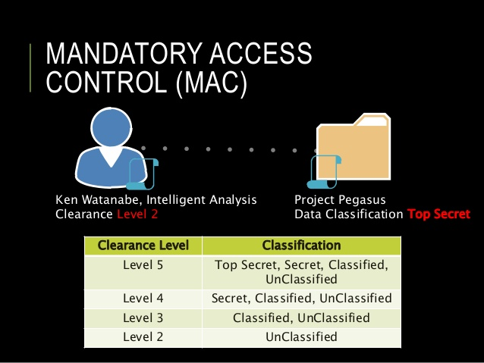
Mandatory Access Control (MAC)
This is a security model in which access rights are regulated by a central authority based on multiple levels of security. Often used in government and military environments, classifications are assigned to system resources and the operating system (OS) or security kernel. It grants or denies access to those resource objects based on the information security clearance of the user or device. For example, Security Enhanced Linux (SELinux) is an implementation of MAC on the Linux OS.

Slide 9
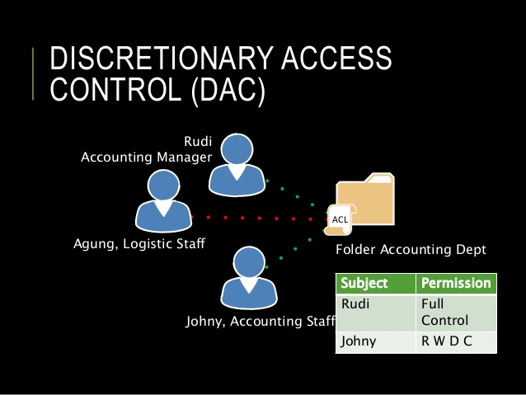
Discretionary Access Control (DAC)
This is an access control method in which owners or administrators of the protected system, data or resource set the policies defining who or what is authorized to access the resource. Many of these systems enable administrators to limit the propagation of access rights. A common criticism of DAC systems is a lack of centralized control.

Slide 10
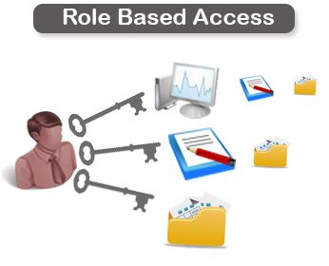
Role-Based Access Control (RBAC)
This is a widely used access control mechanism that restricts access to computer resources based on individuals or groups with defined business functions -- e.g., executive level, engineer level 1, etc. -- rather than the identities of individual users. The role-based security model relies on a complex structure of role assignments, role authorizations and role permissions developed using role engineering to regulate employee access to systems. RBAC systems can be used to enforce MAC and DAC frameworks.

Slide 11
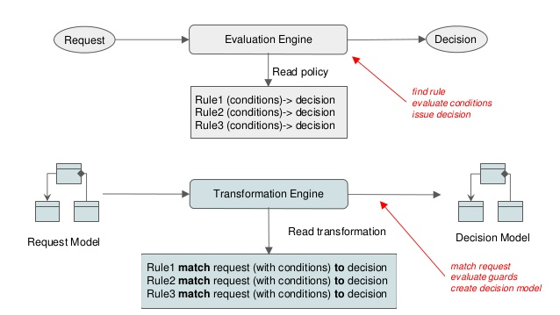
Rule-Based Access Control
This is a security model in which the system administrator defines the rules that govern access to resource objects. Often, these rules are based on conditions, such as time of day or location. It is not uncommon to use some form of both rule-based access control and RBAC to enforce access policies and procedures.

Slide 12
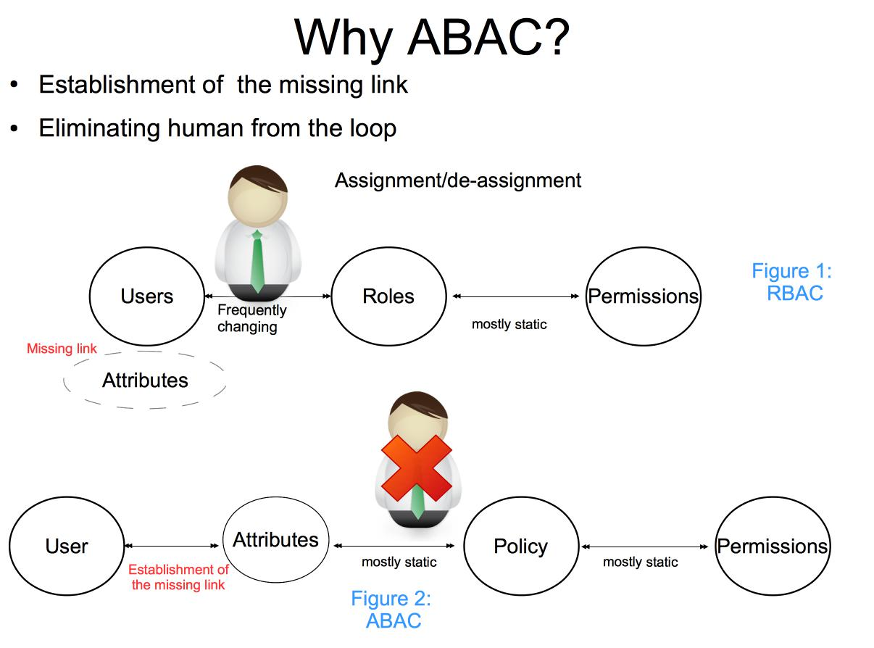
Attribute-Based Access Control
This is a methodology that manages access rights by evaluating a set of rules, policies and relationships using the attributes of users, systems and environmental conditions.

Slide 13
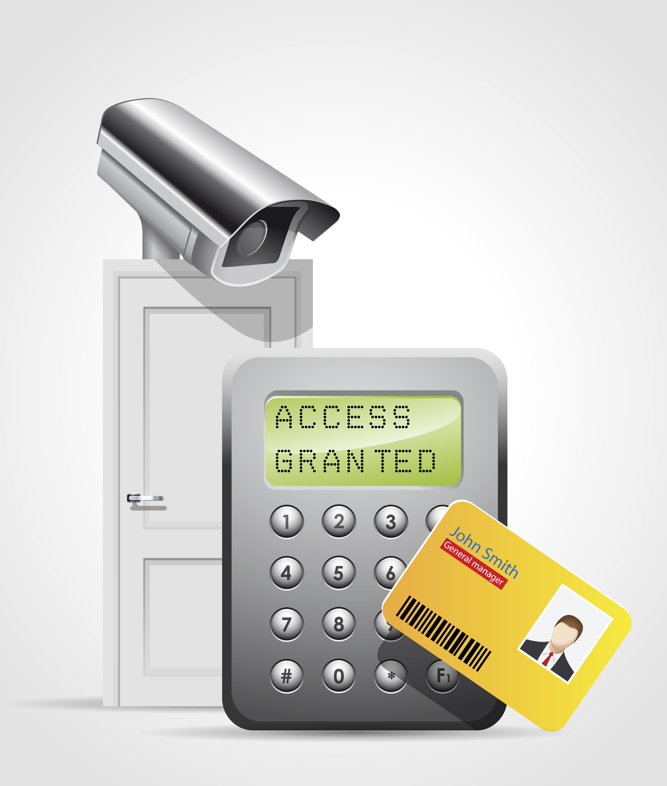
Implementation
Access control is a process that is integrated into an organization's IT environment. It can involve identity management and access management systems. These systems provide access control software, a user database, and management tools for access control policies, auditing and enforcement.
When a user is added to an access management system, system administrators use an automated provisioning system to set up permissions based on access control frameworks, job responsibilities and workflows.
The best practice of least privilege restricts access to only resources that employees require to perform their immediate job functions.

Slide 14
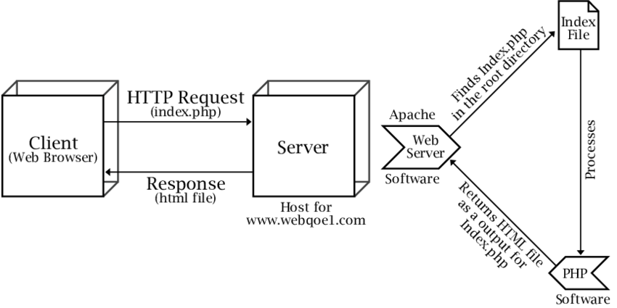
Web Server Lockdown

Slide 15
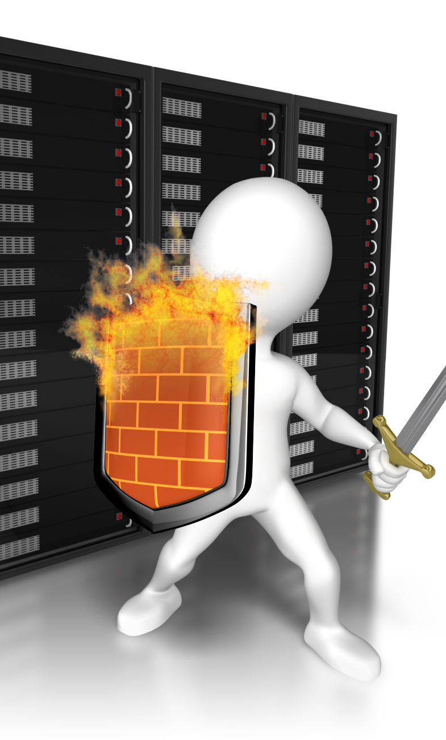
Web Server Lockdown
Contents:
What is Server Lockdown?
The Process of Locking Down a Web Server
Handling Directory and Data Structures
Eliminating Scripting Vulnerabilities
Logging Activity
Performing Backups
Maintaining Integrity
Finding Rogue Web Servers

Slide 16

What is Server Lockdown?
Most web servers belong to large businesses that store a ton of information on the web server. Some of this information can be of the kind that the business does not want to share with the world. In order to protect that information, it is important to make the web server secure. This process of making a web server more secure is called server lockdown.

Slide 17

The Process of Locking Down a Web Server
Locking down a Web server follows a path that begins in a way that should already be familiar: applying the latest patches, managing access control, and updates from the vendor. However, there are more parts of this process. These are:
Handling Directory and Data Structures
Eliminating Scripting Vulnerabilities
Logging Activity
Performing Backups
Maintaining Integrity
Finding Rogue Web Servers

Slide 18

Handling Directory and Data Structures
Planning the hierarchy or structure of the Web root is an important part of securing a Web server. The root is the highest-level Web in the hierarchy that consists of Webs nested within Webs.
Whenever possible, Web server administrators should place all Web content within the Web root. All the Web information (the Web pages written in HTML, graphics files, sound files, and so on) is normally stored in folders and directories on the Web server.
If users accessing these Webs must have access to materials on another system, such as a database, it is best to deploy a duplicate database server within the Web server's Demilitarized Zone (DMZ) or domain. The duplicate server should contain only a backup, not the primary working copy of the database. The duplicate server should also be configured so that no Web user or Web process can alter or write to its data store.

Slide 19

Eliminating Scripting Vulnerabilities
Maintaining a secure Web server means ensuring that all scripts and Web applications deployed on the Web server are free from Trojans, backdoors, or other malicious code. Many scripts are available on the Internet for the use of Web developers.
However, scripts downloaded from external sources are more susceptible to coding problems (both intentional and unintentional) than those developed in-house.
If it is necessary to use external programming code sources, developers and administrators should employ quality assurance tests to search for out-of-place system calls, extra code, and unnecessary functions. These hidden segments of malevolent code are called logic bombs.

Slide 20

Logging Activity
Logging, auditing, or monitoring the activity on a Web server becomes more important as the value of the data stored on the server increases. The monitoring process should focus on attempts to perform actions that are atypical for a Web user. These actions include, among others:
Attempting to execute scripts
Trying to write files
Attempting to access files outside the Web root

Slide 21
Performing Backups
While it is possible to protect your system and delay the eventual attack your server gets, it isn’t possible to eliminate the chance.
Due to this, it is important to make Backups that will allow your server to run again even after an attack.
Backups should be made consistently and can be made daily.
It is also important to not release your backup schedule as this can cause attackers to attack right before the backup process and this would cause infected files to get backed up.

Slide 22

Maintaining Integrity
Locking down the Web server is only one step in the security process. It is also necessary to maintain that security over time. Sustaining a secure environment requires that the administrator perform several tasks on a regular basis such as:
Continuously monitor the system for anomalies
Apply new patches, updates, and upgrades when available
Adjust security configurations to match the ever-changing needs of the internal and external Web community.
If a security breach occurs, an organization should review previous security decisions and implementations. Administrators might have overlooked a security hole because of ignorance, or they might have simply misconfigured some security control.

Slide 23
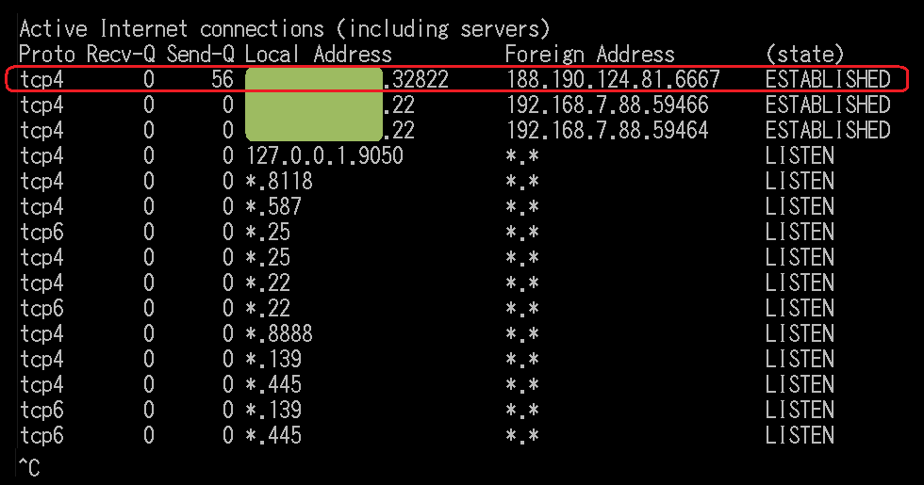
Finding Rogue Web Servers
Sometimes network administrators can discover servers on the network that they are not aware of. These are sometimes called rogue Web servers, and they can come about in two ways. It is possible that a user on the network has intentionally configured Web services on their machine.
To find and remove the server, go to Control Panel and open the Add/Remove Programs applet. If you navigate to Add/Remove Windows Components, you can check to see if you have IIS checked off, which would also indicate that the Web server software is installed. You can see that IIS is checked so that it is installed. To completely remove the Web server, make sure it is not checked at all; this means it will not be installed.

Slide 24
References
https://sourcedaddy.com
https://www.cloudflare.com/
https://en.wikipedia.org/wiki/Web_server
https://en.wikipedia.org/wiki/Access_control
https://www.csoonline.com/article/3251714/what-is-access-control-a-key-component-of-data-security.html
https://www.google.com/search?q=geeks+for+geeks&oq=geeks+&aqs=chrome.1.69i57j0l2j69i60l4.2669j0j9&sourceid=chrome&ie=UTF-8

Slide 25


